Slide 1
Get to know my working style
Nitin Mathur

Slide 2
Table of Contents
Slide 3: What I look for in a Great Engineer
Slide 4: What disappoints me?
Slide 5: Great Engineer - General Expectations
Slide 6: Great Engineer - Technical Expectations
Slide 7: Great Engineer - Code Review Expectations
Slide 8: My philosophy on Learning and Development
Slide 9: My philosophy on Leaves
Slide 10: My philosophy on Team work
Slide 11: My philosophy on Hiring
Slide 12: How I would prefer to have 1x1
Slide 13: Sync ups meeting Expectations
Slide 15: My personality quirks

Slide 3
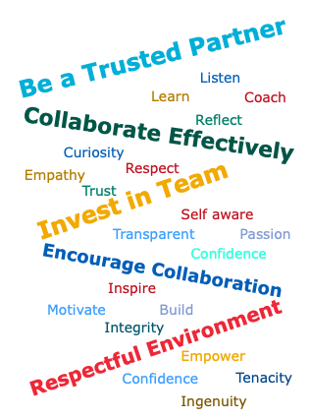
What I look for in a Great Engineer
Think Big
Take risks in every project that you embark on. Weigh the risks and the returns aka ROI.
You’ll be surprised most of the time, risk is either assumed know-how or underestimating your-self and not real risks.
If results become scary, the learning are still very valuable. It tests the boundaries of what can be done..
Not taking risks IS RISKIER than Taking risks.
Sometime, gut feeling make things happen. Trust your gut.
If you can justify associated risks, you‘ll always find me backing you.
Make things Happen
Take charge; Make prototypes and Get it Done.
No skillset can compensate ‘lack of ownership;
Showcase what you’ve developed iteratively and with improvements
It’s ok to make mistakes but recover quickly from them*
Do it quickly aka “Sense of urgency”
Tricky one, since this expects you to work hard in meeting goals. But that’s the challenge; Haven’t we heard Normal is boring.
In my view, a key ingredient to success is “Fire in the belly”? How do our day-to-day actions reflect this trait?
Take Help : Enables you to
Do things quickly.
Empower others to think on your projects.
People with more information often make better decisions and make the greatest impact.
Keeps all stakeholders informed
Over Communicate: Get your thoughts planted in everyone’s brain.
Open and Transparent Communication
·
Don’t forget to Smile
*How quickly you recover from your mistakes is a part of professionalism

Slide 4

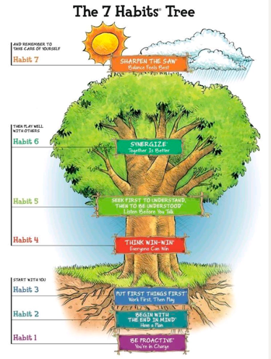
Ref: Seven habits of Highly Effective People - Steven covey
Habit 1 : Be Proactive - You’re in-charge
Habit 2 : Begin with the End in mind - Have a plan
Habit 3: Put First things First - Work first, then Play
Start with you
Habit 4: Think win-win - Everyone can win
Habit 5: Seek first to understand, then to be understood
i.e. Listen before you talk.
Habit 6: Synergize - Together is Better
Then play well with others
Habit 7: Sharpen the Saw - Balance feels Best
Remember to take care of yourself

Slide 5
What disappoints me?
Not taking care of Review comments from the requirement, design and code discussions.
I don’t like to give the same feedback, multiple times.
When a feedback was discussed, and if I don’t see any progress there, I see it as a waste of my time, and effort.
If the feedback doesn’t resonate with you;
bring it up during the actual discussion.
If you weren’t comfortable to discuss along with other team members, bring it after the meeting
Before we leave any meeting, we must agree on one thing and have the same thoughts.
Not speaking up when the time is right. Don’t complain later on, when things go out of control
Poorly framed sentences/designs in Emails/ Design Documents/ Discussions
I’m not talking about grammar here. Complete-message has to be conveyed.
Over-communicate your requirements, designs, documents or code. Importantly, the thought should get planted and communication should be understandable in your absence.
Responding to stakeholders
Incomplete or half baked responses. Over communicate, plant your thoughts into another person’s mind.
If certain work/email/message needs an immediate response, it must be immediate or as soon as it was possible. If a response is not given in time, then it has no meaning and frustrates me.

Slide 6
Great Engineer - General Expectations
Knowledge | Supervision | Innovation
Working knowledge in your core domain and several technical areas within the domain Very Solid know-how on project areas Understanding of Test infrastructure to ensure seamless execution of projects Mastery in understanding the HW/SW of Test equipments to test your code Displays high level of technical competence to Solve & Prevent problems in FW, SW, Test packages and Test-infra FA/debug host or tester issues found during the run of any test Provide inputs to each group’s technical strategy and contribute to overall technical direction for project work. Able to identify risks and generates, recommends, and implements solutions | Meets group’s objectives with minimal direction and supervision Structure work plans & manage execution of smaller tasks independently Able to follow all established process and guidelines, esp wrt to code reviews, and FA techniques. Effectively communicates and coach's various stakeholders on all project related algorithms | Able to write atleast one blog (or wiki) or paper or patent or give a tech talk once a year Influence the group through technical innovation and industry practices. Shows a high degree of thought-leadership within project teams Propose continuous improvements on FW, SW and HW Infrastructure and ensure predictability in development, bugs, failures and analysis

Slide 7
Great Engineer - Technical Expectations
Do you understand “what is needed” ?
Write code that enables others to understand it easily
How scalable, modular and extensible design is it that you propose ?
How many design patterns do you use in the design?
How are you reducing technical debt in the overall architecture and designs ?
How close is your design document to the implementation
Did you unit test the code ?
Visualize the design, and explain where to expect the bugs,
How do you intend to test the corner cases

Slide 8
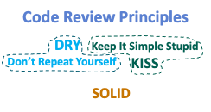
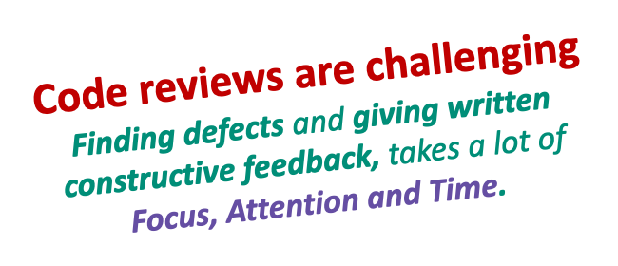
Great Engineer - Code Review Expectations
Process should fix clear expectations for authors and reviewers.
Authors Responsibilities
Carefully prepare a description and choose reviewers familiar with code.
Code review descriptions are important but should be brief and concise.
Specify both, what the code is doing and why this is done in that way.
Include reasons behind any trade-off & links to external resources when necessary.
Writing Effective Comments
Requires an iterative process.
First write comments as you go through the code to clarify your thoughts.
Then change and rewrite them while getting a clearer picture of the code.
Effective review comments should:
Address the code and not the author
Clearly indicate if a remark is not blocking
Give a reason why a change should be done
Give possible suggestions for solving a problem
Shipping code with few review cycles require writing better code:
Have an opinion about what’s a readable code.
Be empathic: Value the readers time more than yours.
Be intentional: Backing any line of code to your opinions.
Consider Code Reviews as ‘teach-the-feature’ opportunity.
Reviewers Responsibilities:
Reviewers should show ownership and responsibility, being kind and thorough while writing comments.
Review slowly.
Look for flaws inside the diff like:
Missed corner cases or possible optimizations,
side effects on other parts of system;
Check for backwards compatibilities changes.
Suggest refactoring (or partial refactoring) that maybe possible to ensure modularity and scalability
Ideate unit tests as you review code;
Comment on the code, and not the author. Do not nitpik.

Slide 9
My philosophy on Learning and Development
As a first step, you’ll need to bring “your learning plan” to me. I’ll step in with my thoughts once, you show interest.
No one learning system is good; people buy and reimburse.

Slide 10
My philosophy on Leaves
Your leaves are totally yours. I trust your judgements on taking leaves when its deemed necessary.
As long as you follow company guidelines, we do not care for the reason you are taking it, nor will i ever ask an explanation on why you are taking it. .
Just take care of the following:
Apply for leave in Advance on the system, as per policy. Your leave will be auto approved by me, if the tool doesn’t do it.
Let your teammates know about your leaves, its helps them to take over unfinished business. Don’t leave any one in lurch.
If its a sick leave, setup a reminder in Teams/ Outlook. That’s enough!
Never ever apologize for taking PTO or think twice about reasons you’ve to give. As far as I am concerned, i just need to know your availability/ unavailability.
We operate in an environment of Trust.

Slide 11
My philosophy on Team work
Collaborate, collaborate and collaborate. This is the key to success.
Collaborate at all levels; functional level and cross functional level, your peers, friends and colleagues. Find ways !
The strength of the team is each individual member. The strength of each individual member is the team.
We work in a team which has multiple options on Engineers who score. We don’t build around a single batsman.

Slide 12
My philosophy on Hiring
We don’t need Exceptionally Talented people;
We want Talented people who do Exceptional work
Diversity in hiring brings varied thoughts, voices into the team.
Collective capabilities and Different perspectives of men/women; Experienced/Inexperienced; Young/Old
Remote work, Engineers working across geographies
Remove familiarity bias (i.e. hire people who are not the same)
Use multiple interviewers to check for job-alignment, skill gaps, and cultural fit.
High Competency, Right Attitude are clearly important traits but not the only traits to work in this team.
Cultural fitment is critical to the job.
Communicative and Approachable by all
Use small assignments / problems to solve to judge competency
Judge candidates seriousness about this job.
Tenacity to perform under pressure and critical situations.
Team Player: There is little space for nerds and geeks who cannot work with the team.

Slide 13
How I would prefer to have 1x1
The 1x1s are your meeting, so you decide the agenda and the meeting frequency. I'm here to listen and work on issues that are important to you. If you do not have anything to discuss, you cancel the meet.
You can discuss anything non-operational in these meetings. Discussions related to career growth, something bothering, clarification around some company process/policy, company culture, what's happening in other departments etc.
If I do not have the answer to your query at the moment, I would take note of it, find the answer and then update you.
I‘ll use a small section of your time in the 1x1 meeting to communicate to you any feedback that's relevant which can be worked upon by you.
Also, just because 1x1 happens once a month, it doesn't mean if there's anything that's eating up your mind you need to wait for the next 1x1.
If there is a point of concern, you’ve heard a rumor, you need clarification, you are blocked, need a pep talk, vent your frustrations or anything else, put it in my calendar or message me, I’ll find time to talk as soon as i can.

Slide 14
Sync ups meeting Expectations
If there is a need to do a sync up meeting, I will facilitate it. The meeting can last from 15 mins to 2 hours (if it needs a design discussion or online code review). Believe me, I won’t waste your time.
Usually, I set-up agenda for meetings but if i don’t do, please remind.
Meetings should have active participation from all people attending it.
It’s important to bring your own ideas and thoughts (or technical opinion) to the meetings.
I don’t prefer to have anyone remain aloof in the meetings.
If you don’t want to attend the meeting, please decline the invite. I won’t feel bad or sad.
If you need my urgent attention, I prefer Async communication i.e. text me over MS Teams or slack.
If I missed responding to your message for a good amount of time (say > 1 hour), most likely, I forgot or got distracted by other activities. You can remind me to gain my attention.

Slide 15
My Philosphy on Compensation and Appraisals
Technical Competence
Performance in the last cycle
Potential to execute in the next cycle
Behavioural Competence
Team Player
Collaboration with stakeholders
Proactiveness
Ability or future potential to deliver the work on own despite complexities in the project
Any other factors ???
Business and Market factors
Are we in a recessionary mode or market is booming
Is the person under observation on the higher/ mid/lower end of position
Any other factors ???

